Slide 1
Spring Semester Physical Fitness
Staff Sergeant Shawn A. Welch, Midn 2/C Garza & Midn 1/C Kelly

Slide 3
Overview
NROTC Houston Consortium Instruction/Changes
PT Plan
PTDO/How to conduct PT
Expectation/Motivation

Slide 4
PT Instruction/Changes
All personnel within the Consortium are required to PT a minimum of three time a week.
Unit PT – Once a month.
Navy/Marine PT – Required by all MIDN/MECEPs. Once a week.
Remedial PT – Held twice a week. Required if on FEP.
Can substituted Marine PT.

Slide 5
Instruction Continued
FEP – “Good Low” or Second Class PFT/CFT.
Will remain in FEP until they pass final PRT/PFT/CFT.
Body Composition.
PTDO – Assigned 1/C or 2/C to lead Navy remedial PT.
Marine PTDO
Marine PT

Slide 6
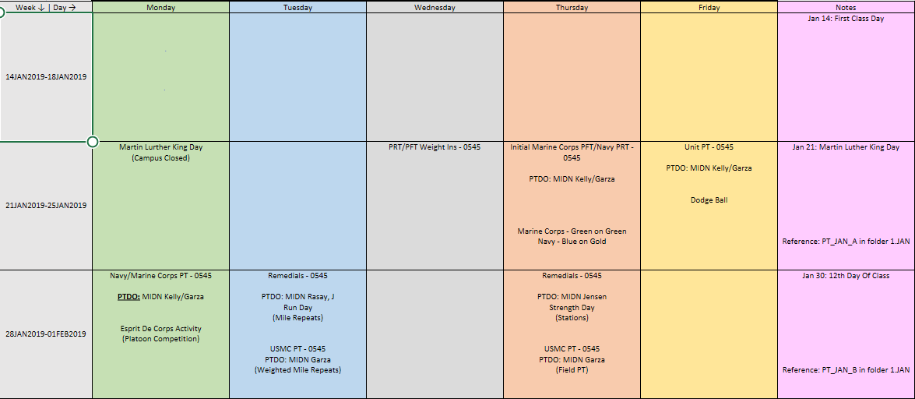
PT Plan
Folder: PT_SPRINT_2019
Excel Sheet.
Month/Week
Reference – Word Document
Subject to Change
Online

Slide 7
PT Plan Continued
Go to: https://github.com/NROTC-Houston-Consortium/PVAMU_PT
Or go to: https://drive.google.com/drive/folders/1BSovgwT2qsIxt-WcoWM-_fHHqML8bhpV?usp=sharing

Slide 8
PTDO
Accountability.
FEP Roster.
Conduct PT – Detailed Plan.
Equipment
Safety.
Flexible.
Don’t hesitate to make command decision.
Inclement Weather Plan.

Slide 9
Three Basic Principles of Exercise
Specialization(PRT/PFT/CFT)
Overload (Getting out of your comfort zone)
Progression (Body adaptation)

Slide 10
Expectations
https://www.youtube.com/watch?v=zASb8m_nLZw

Slide 11
Become the professional
https://www.youtube.com/watch?v=Vb9rYBmYHuE

Slide 12
References
NROTC Houston Consortium Instruction 6110.1
MCO 1500.62 (Force Fitness Instructor Program (FFIP)
https://breakthroughfitnessfl.com/blog/3-basic-principles-of-exercise/

Slide 13
Questions?

